Slide 1
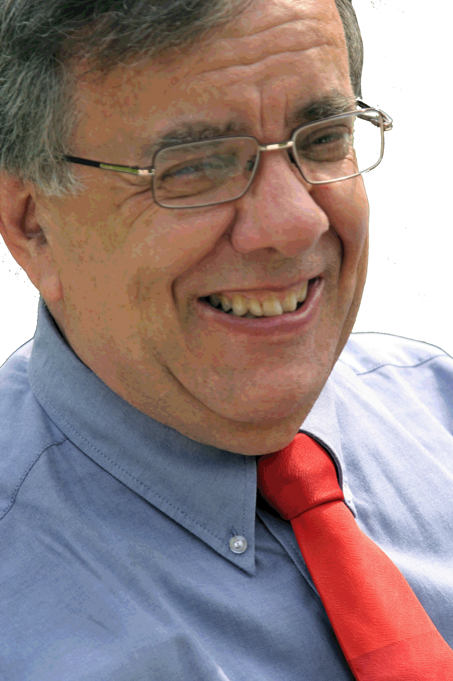
The Human Mind Through Film
Dr. Joe Mior - Frost 221 Brealey 568
Joe.mior@flemingcollege.ca

Slide 2
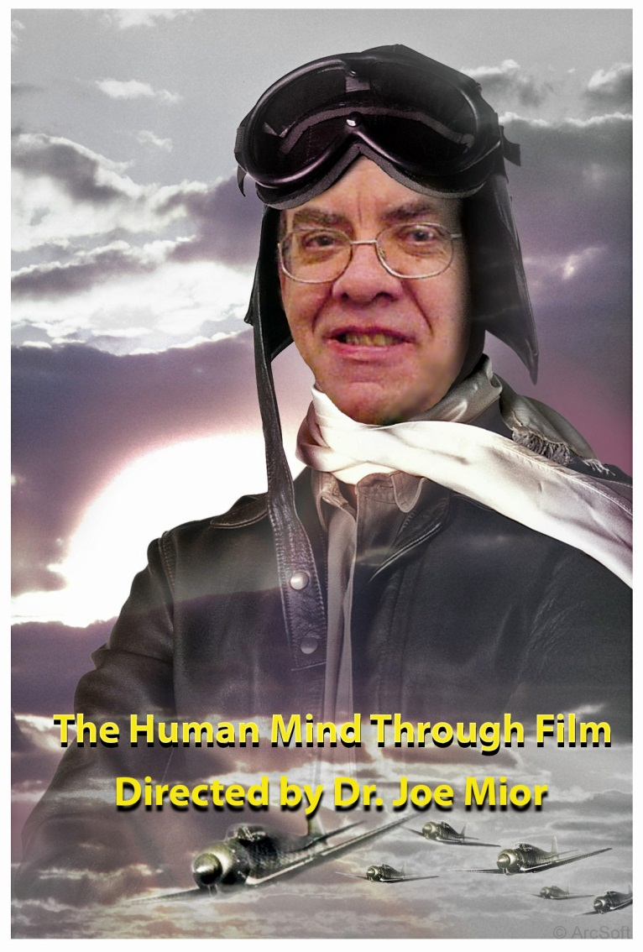
Course Web Page
drjoe.ca

Slide 3
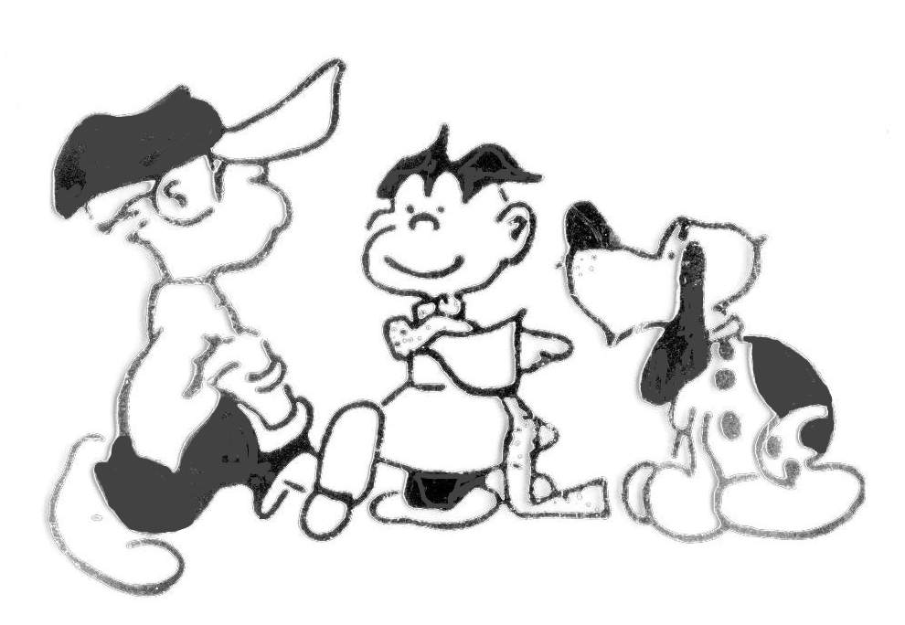
My Teaching Philosophy
I taught snoopy how to whistle!

Slide 4
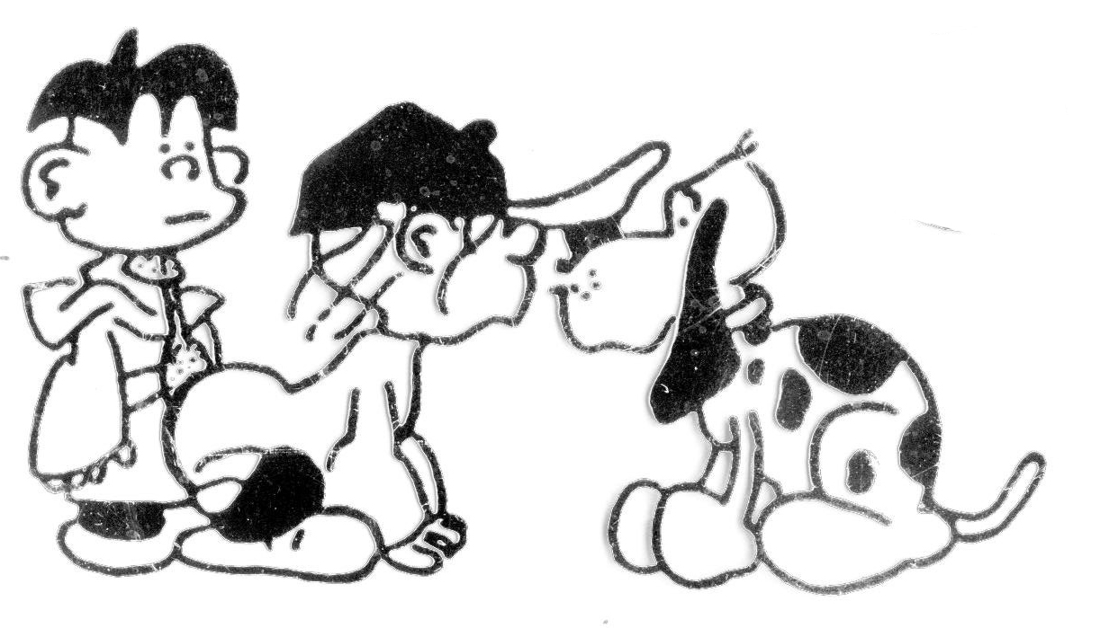
My Teaching Philosophy
I can’t hear him whistling!

Slide 5
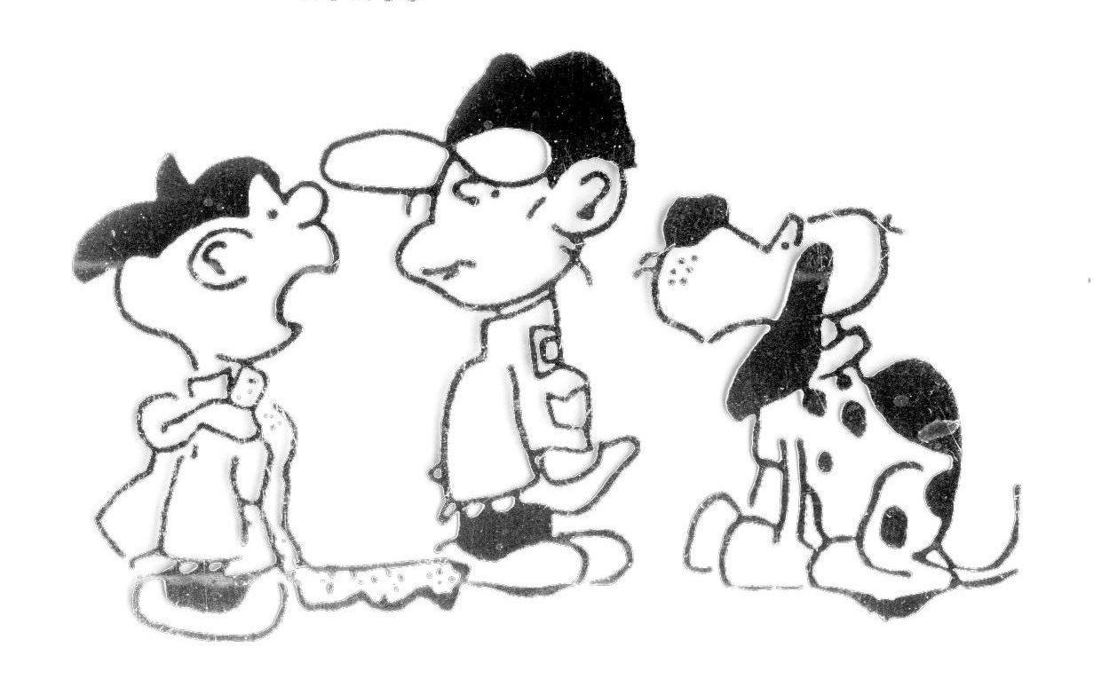
My Teaching Philosophy
I said I taught him.
I didn’t say he learned it!

Slide 6
Aim
This course examines the intricacy of the human mind and human behaviour through the critical analysis of current popular films. It is intended to foster an appreciation of film as an art form of communication. Further, it will challenge students to develop the skills and habits of perceptive watching and discover aspects of film art that they may otherwise overlook. These goals will be accomplished through weekly screenings, lectures and discussion.

Slide 7
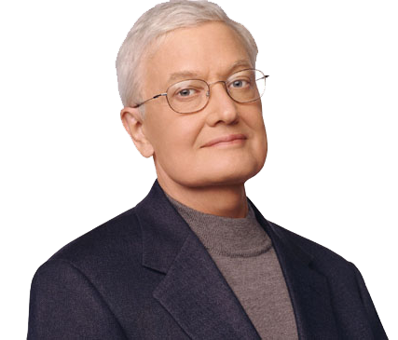
Roger Ebert Film Reviewer
“I believe movies can be noble and good for the soul. They are empathy machines, allowing us for an hour or two to understand a little of what it would be like to be somebody else. To be a different race or gender or religion, or live at another time or under other politics. They help to make us citizens of mankind.
Of course most movies are shallow or silly, but sometimes there are movies that shake us up and make us deeper and better.”

Slide 8
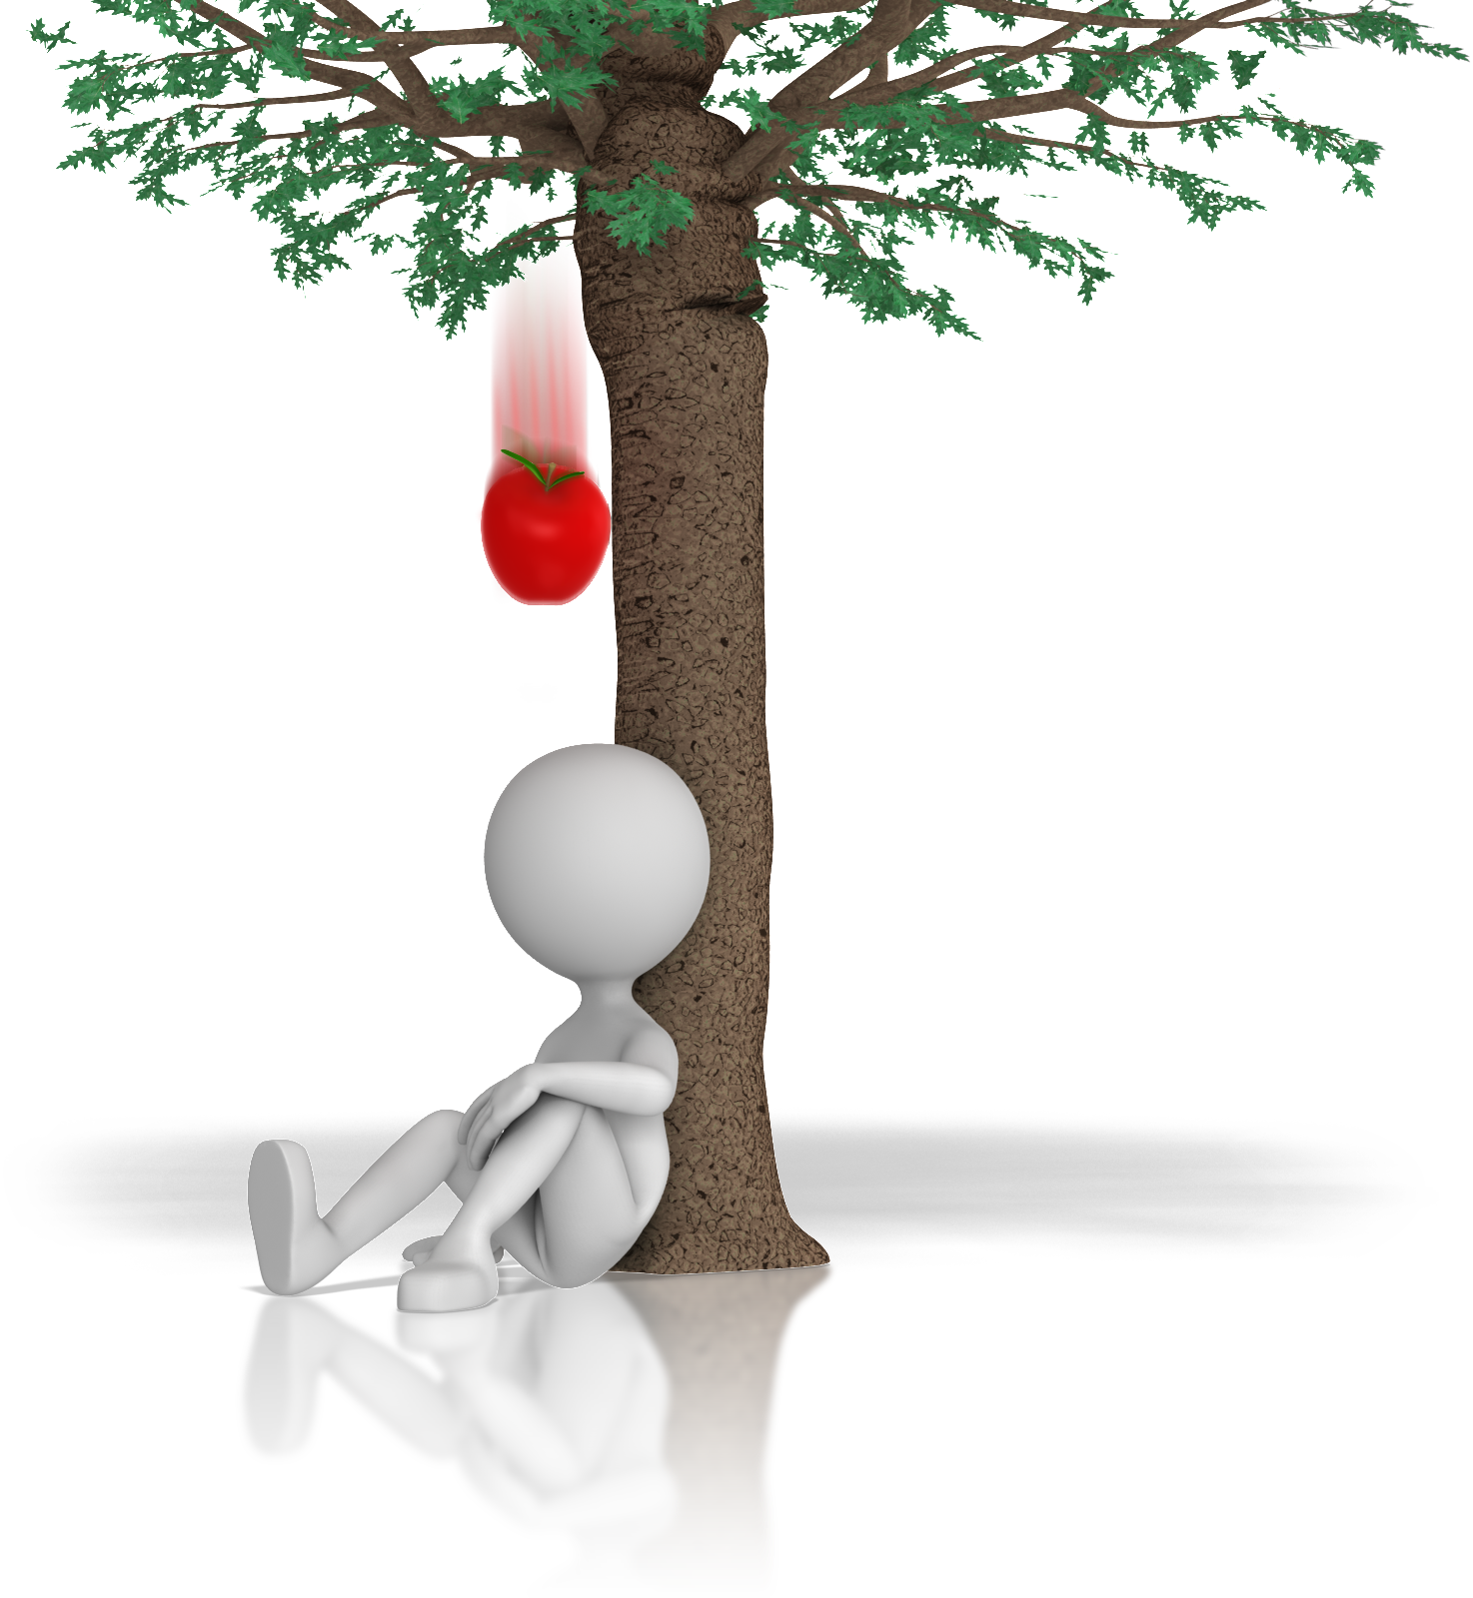
Our Goal
To challenge you to sharpen your powers of observations
To help you to develop the skills and habits of perceptive watching
To encourage you to discover complex aspects of film art that you might otherwise overlook

Slide 9
The Whole Film
To appreciate a movie you have to consider it as a whole.
Some parts may be intriguing in themselves, but the film operates as a total system.
Any part gains its full meaning in that context.
You will appreciate the film most fully if you have an overall sense of how it is put together.

Slide 10
How To Watch
Watch with particular concentration
Start to develop a film memory
Decide to notice certain aspects of film technique
Note how sounds, colours and locales are differentiated
Repeated viewings, whenever possible are desirable as is note taking

Slide 11
Film Review
Makes an evaluation of the film.
Essentially it is a judgment about the quality of the movie, backed up with enough information to indicate that your judgment is based on good reasons.
Film criticism isn’t devoted to finding fault.
Most films aren’t perfect – even weak films have good points.
A sensitive critic tried to take both the pluses and minuses into account.

Slide 12
Film Review Characteristics
Film review is a genre of journalistic writing
Must contain a brief plot synopsis, suggesting the main conflicts and character developments
Mentions striking aspects of the film such as notable visual quality, music, and, above all acting

Slide 13
Key Questions for a Film Review
Have you somewhere clearly indicated your judgment of the film’s quality?
Have you provided a brief plot synopsis?
Have you mentioned specific elements of the film which support your judgment?
Have you qualified your judgment by balancing positive and negative aspects of the film?
Have you begun the review with an attention-grabbing opening? Have you concluded with a striking sentence?

