Slide 1
The Power of Compassion

Slide 2
THE BLIND SIDE

Slide 3
A homeless African-American youngster from a broken home, Oher is taken in by the Touhys, a well-to-do white family who help him fulfill his potential on and off the football field. At the same time, Oher's presence in the Touhys' lives leads them to some insightful self-discoveries of their own.

Slide 4
SANDRA BULLOCK plays Leigh Anne Tuohy the headstrong wife and mother, who, with a simple act of kindness, brings Michael Oher in out of the cold, literally and figuratively.

Slide 5
QUINTON AARON plays Michael Oher, a gentle giant who grew up in the abandoned poverty-stricken projects of Memphis, appropriately called Hurt Village, Michael had had few options and even fewer opportunities.

Slide 6
TIM McGRAW plays Sean Tuohy an all-around good guy and inspirational husband. What he and his family did for this kid--the time, the effort and the love he put out--is pretty incredible.

Slide 7
Off the football field, the person most responsible for Michael getting into college was his tutor, Miss Sue, who became an extended member of the Tuohy family. She is played by KATHY BATES.

Slide 8
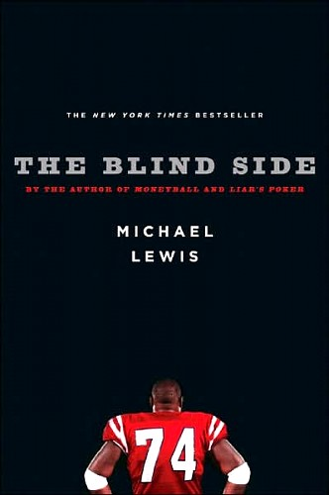
THE MOVIE IS BASED ON A BEST SELLER How Michael Oher became a part of the Tuohy family was first chronicled in the best-selling book The Blind Side: Evolution of a Game, written by Michael Lewis, who had previously focused on the sport of baseball in his bestseller Moneyball.

Slide 9
Teenager Michael Oher is surviving on his own, virtually homeless, when he is spotted on the street by Leigh Anne. Learning that the young man is one of her daughter's classmates, Leigh Anne insists that Michael--wearing shorts and a t-shirt in the dead of winter--come out of the cold.

Slide 10
Without a moment's hesitation, she invites him to stay at the Tuohy home for the night. What starts out as a gesture of kindness turns into something more as Michael becomes part of the Tuohy family despite the differences in their backgrounds.

Slide 11
Living in his new environment, the teen faces a completely different set of challenges to overcome.

Slide 12
And as the family helps Michael fulfill his potential, both on and off the football field, Michael's presence in the Tuohys' lives leads them to some insightful self-discoveries of their own.

Slide 13
The Blind Side was filmed almost entirely on location in Atlanta, Georgia, which doubled for Memphis, Tennessee, where location scenes underscored the themes of the story.

Slide 14
THE TWO WORLDS The direct contrast between the housing project and the polar opposite neighbourhood where the Tuohy family live personifies Michael's journey.

Slide 15
Reactions

Slide 16
THE VALUE OF THE UNDERVALUED "Michael was once completely devalued in the world. Imagine what kind of value we put on kids like him who don't happen to be athletic. Imagine who gets passed by and that's a shame. I think this story says we need to do more to help kids, all of whom have value.” -- Sean Tuohy

Slide 17
FAMILY "The beauty of the story is that you think it's one thing and it turns out to be something else, and those are usually the best things in life. I thought the script was going to be about football until I read it and realized that it's really about family.“ --Sandra Bullock

Slide 18
Changes comes through relationships. "I think Michael had a much greater impact on our lives than we did on his. You take so much in life for granted, but when Michael moved in with us, he made us realize how blessed we are. We viewed life differently after he joined our family.” --Leigh Anne Tuohy

Slide 19
BEING A GOOD SAMARITAN “It's an inspiring story in a world that's divided, in large part, by the 'haves' and the 'have-nots.' It shows that you can be a good Samaritan and it can benefit you as much as the person you're helping. I think it's very entertaining, but it's also very powerful.” -- Producer Broderick Johnson

Slide 20
An Act Of Kindness Changes Everything!

