Slide 1
Welcome to Career and Workplace Essentials

Slide 2
What’s in it for you?
In the Career and Workplace Essentials course you will:
1. Gain Awareness of Canadian Business System
Functional areas of business
Expectations of potential workplaces
Explore critical issues affecting businesses
2. Understand the implications of business decisions made by your employer or running your own business
3. Learn about business through case analysis
4. Develop awareness of your working style

Slide 3
Understanding the Canadian Business System

Slide 4
Learning Objectives
Define the nature of Canadian business and identify its main goals
Describe different types of global economic systems, according to the means by which they control the factors of production through input & output markets
Show how demand and supply affect resource distribution in Canada
Identify the elements of private enterprise and explain the various degrees of competition in the Canadian system
Notes:
These learning objectives are based upon those at the beginning of the chapter. For a review of the learning objectives, see the summary at the end of the chapter, as well as the Questions and Exercises, Application Exercises, Team Exercises and other exercises . Business Case # 1 is also located at the end of the chapter.

Slide 5
It’s an exciting time to be in business…
The Internet and improved communication have changed how we do business.
Technology has changed how we produce and deliver goods and services.
Companies are expanding globally.
An expanding, diverse workforce is changing how we manage our employees.
Companies are being held accountable for their behaviour.

Slide 6
Two Reasons to be in Business
Make Money
Have Fun

Slide 7
The Concept of Business and Profit
Businesses produce and/or sell products and/or services in order to make a profit.
Notes:
Learning Objective: 1
Notes
The text focuses on businesses only, since they generate profits. However, this discussion can be expanded to include other organizations that are active in our society which are not profit-based:
- charitable organizations
- government enterprises
The difference is that the profit motive is not present, so volunteerism is an important part of the organization’s composition.
Profits, (or funds received in excess of expenses) are called surpluses in not-for-profit organizations.
Activity
Have students research a corporation in the library using the corporate reports. Have the students work in groups to identify the products/services sold, and the profitability of the firm in return for risking its assets to produce the goods.
Have students make a list of all the not-for-profit organizations they can think of.
Ask students to list what constitutes revenue and expense.

Slide 8
What’s the difference between a “Good” and a “Service”?
Goods
Athletic shoes
Apparel
Equipment
Services
Banking
Legal
Medical
Travel

Slide 9
Profit
The money left over from revenues after a firm pays its expenses
Motivates individuals to engage in business activities
Profit
Revenue
Expense
Profit = Revenue - Costs of generating revenue

Slide 10
Some Businesses Are Set Up To Make A Profit And Others Are Not
For Profit
vs.
Nonprofit

Slide 11
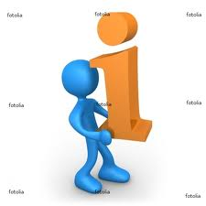
Resources: Inputs and Outputs (Factors of Production)
Entrepreneurship
Land
Business
(Transform)
Information
Capital
Labour
Outputs
Goods
Services
1-11
Notes:
11

Slide 12
Business Participants (Stakeholders)
Owners/
Investors
Customers
Community
Employees

Slide 13
Business Activities
Functional Areas of
Business:
Management
Operations
Marketing
Accounting
Finance
Notes:
13

Slide 14
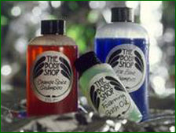
Is that all there is?
Business Goals:
To earn a profit
Anything else?
1-14

Slide 15
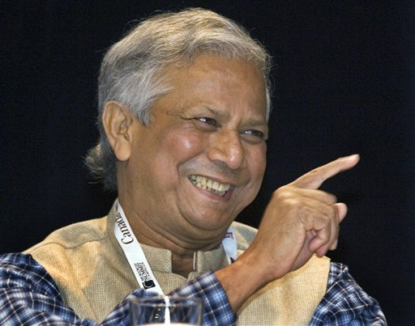
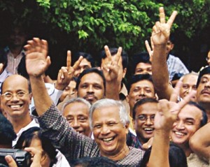
Muhammad Yunus

Slide 16
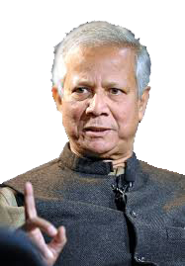
Muhammad Yunus: Building Social Business Ventures
Dr. Muhammad Yunus (& Gremin Bank)– Awarded the 2006 Nobel Peace Prize
“Micro Credit” (Bangladesh)
“Social Business or Social Entrepreneurship”

Slide 17
Expanding our Definition of Business
Putting it altogether …
Business is a term describing an organization that seeks to earn profits by providing goods and services, ethically and responsibly.

Slide 18
Resources: Inputs and Outputs Understanding the Economy
Economist Try to Answer Three Sets of Questions
1. What goods and services should be produced to meet consumers’ needs?
2. How should goods and services be produced?
3. Who should receive the goods and services produced?

Slide 19
Types of Economic Systems
Capital $
Labour, Human Resources
Entrepreneurs
Information Resources
Natural Resources
Command
Communism
Socialism
Market
Mixed Market
Government
Businesses
&
Individuals
Factors of
Production
Who Owns / Controls Factors of Production
Notes:
Learning Objective: 2
Notes
This slide illustrates the relationship between economic systems based on ownership / control of the Factors of Production.
Activities
Have students imagine they are running a small business (coffee shop). Ask then to complete a list of everything they will need, categorizing each under its proper Factor of Production.

Slide 20
The Communist Model
Government owns the factors of production, makes all decisions regarding distribution of resources and owns all industries including essential services.
Notes:
Learning Objective: 2
Notes
Be sure to identify the difference between industry, essential services, and ordinary businesses. This is key to understanding this part of the lecture.

Slide 21
The Socialist Model
The government owns and operates all critical industries such as utilities & major institutions
Individuals own non-critical businesses
Notes:
Learning Objective: 2
Notes
Be sure to clarify and give examples of what are considered essential services.
Activities
Ask students in small groups to construct a list of what they consider to be “essential government” services.

Slide 22
Market Economy
Economic basis is supply & demand
Ownership of the factors of production is open to all
Buyers and sellers have freedom of choice
The market is the mechanism for the exchange of goods and services
Notes:
Learning Objective: 2
Notes
In a market economy:
Demand is willingness of consumers to buy a product or service
Supply is the willingness and ability of producers to sell the product or service
The issue of supply and demand is further discussed in additional slides for this chapter, and in the discussion of supply, demand, and price determination in the text.
The issue of choice, ability and interest are all freedoms which students identify with. They tend to approach this from a very strong cultural bias. Through discussion construct a table on the board illustrating the strengths of living in a planned, vs. a market, economy. Force them to list strengths and weaknesses of both systems.
Activities
Questions for Analysis # 2

Slide 23
The Mixed Market Economy
Mixed market economy
a combination of both freedom & government intervention
Most countries have some form of mixed market economy
Notes:
Learning Objective: 2
Notes
China is encouraging entrepreneurial activity
Russia has returned to a non-communist regime
In Canada, many “necessities” or “essential services” are supplied by the state
Activities
Have students analyze the Canadian government system. This is a mixed economy. Let them indicate which aspects of the economic system are controlled by government.
Expand on the first activity by having students compare Canada’s level of government regulation with that of the United States. Then, let them describe which system is more socialistic, capitalistic, etc.
Using the Internet, have students work in small groups to create a list of companies that have been privatized, and industries that have been deregulated in the past 10-20 years.

Slide 24
How Business Influences Government
Business
Lobbyists
Trade Associations
Advertising
Government
Lobbyists must register to be in accordance
with the Lobbyists Registration Act
Notes:
Learning Objective: 2
Notes
Lobbyists are individuals or organizations whose job is to influence key policymakers to make decisions which favour their clients. Lobbyists must be registered in order to do business in Canada. Lobbyists use personal persuasion as well as advertising to accomplish their objectives.
Trade associations, such as chambers of commerce and employee groups also attempt to influence the vote of parliamentarians. Business works directly through its various trade associations to sway opinion of both the general public and policy makers.
Voters can be influenced by business, trade associations, advertising, and politicians.
Activities
Divide students into groups of three or four. Assign each group a politically “hot” topic, such as offshore oil rights, environmental protection, the right of tobacco and alcohol producers to access broad promotion. Then, tell them they must lobby in favor of the cause. Have them prepare a platform and present it. To add to the excitement, have other groups act as politicians with their own personal opinions. Have the “lobby” group attempt to convince the “politicians” to support their cause.

